Slide 1

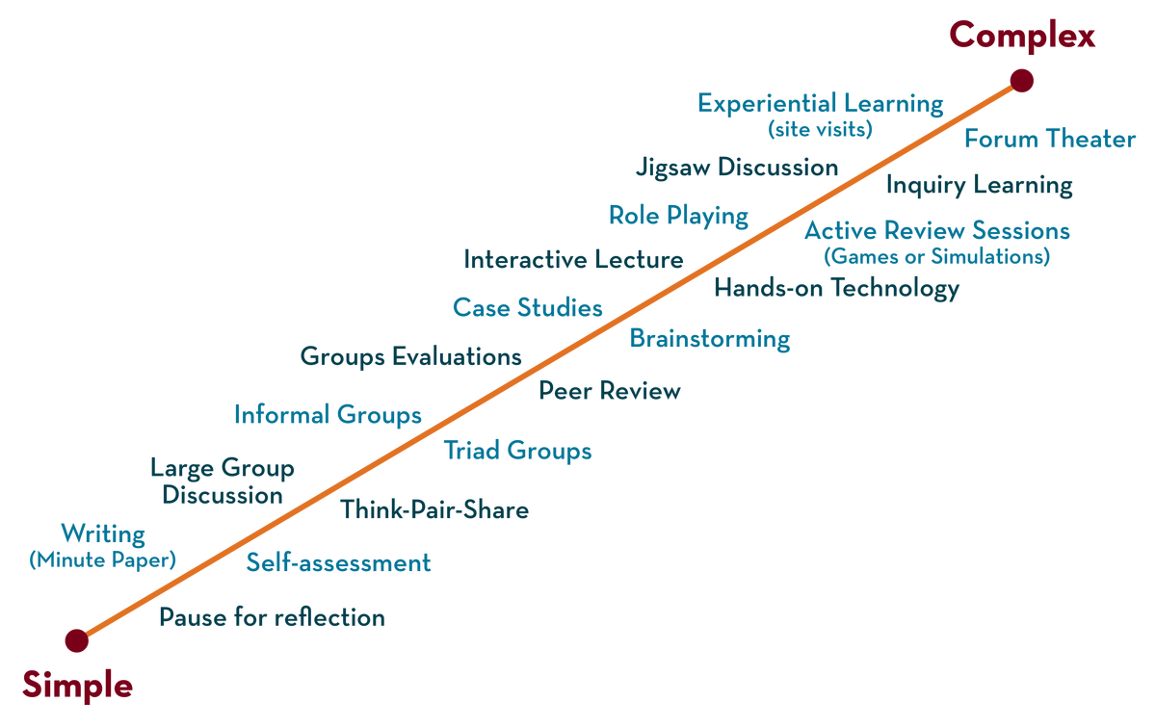
Department of CSE
Deep Learning
20CS3269AA
Topic:
RMS Prop
Session - 10

Slide 2



AIM OF THE SESSION
To familiarize students with the concept RMSPROP algorithm
INSTRUCTIONAL OBJECTIVES
This Session is designed to:
Demonstrate the RMS prop
Know about RMS update rule
Discuss the difference between optimization algorithms
LEARNING OUTCOMES
At the end of this session, you should be able to:
Able to understand rms optimization algorithm

Slide 3
RMSprop
Full form is root mean squared propagation,
It is an optimizer that divides the learning rate by an exponentially decaying average of squared gradients.
This can make it more stable and efficient than SGD, but it may require careful tuning of the decay rate.
RMS prop is ideally an extension of the work RPPROP. RPPROP resolves the problem of varying gradients.
The problem with RPPROP is that it doesn’t work well with large datasets and when we want to perform mini-batch updates.
Achieving the robustness of RPPROP and efficiency of mini-batches at the same time was the main motivation behind the rise of RMS prop.
RMS prop can also be considered an advancement in AdaGrad optimizer as it reduces the monotonically decreasing learning rate.

Slide 4
Why RMSProp
The problem with the gradients is that some of them were small while others may be huge.
A single learning rate might not be the best idea for the optimization
RPPROP uses the sign of the gradient adapting the step size individually for each weight.
In this algorithm, the two gradients are first compared for signs.
If they have the same sign, we’re going in the right direction and hence increase the step size by a small fraction.
Whereas, if they have opposite signs, we have to decrease the step size.
Then we limit the step size, and now we can go for the weight update.
where step size is the learning rate

Slide 5
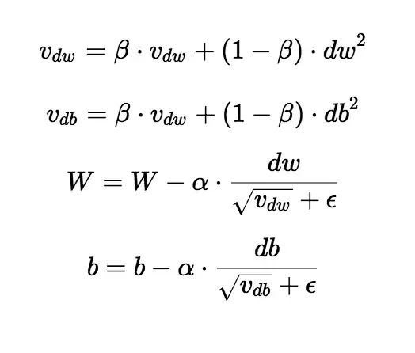
Using RMSProp
The algorithm mainly focuses on accelerating the optimization process by decreasing the number of function evaluations to reach the local minima.
The RMSprop optimizer restricts the oscillations in the vertical direction.
Therefore, we can increase our learning rate and our algorithm could take larger steps in the horizontal direction converging faster.
The algorithm keeps the moving average of squared gradients for every weight and divides the gradient by the square root of the mean square
where beta is the forgetting factor.
weights are updated by the below formula
Sometimes the value of v_dw could be really close to 0. Then, the value of our weights could blow up. To prevent the gradients from blowing up, we include a parameter epsilon in the denominator which is set to a small value.
The difference between RMSprop and gradient descent is on how the gradients are calculated

Slide 6
RMSProp Advantages vs disadvantages
Advantages:
This algorithm has several benefits as compared to earlier versions of gradient descent algorithms.
The algorithm converges quickly and requires lesser tuning than gradient descent algorithms and their variants.
RMSprop uses an adaptive learning rate instead of treating the learning rate as a hyperparameter.
the learning rate varies over time.
RMSprop uses the same concept of the exponentially weighted average of gradient as gradient descent with momentum, but the difference is parameter update.
Disadvantages
The problem with RMS Prop is that the learning rate has to be defined manually and the suggested value doesn’t work for every application.

Slide 7
Rms prop -goes through saddle point
https://miro.medium.com/max/1240/1*Y2KPVGrVX9MQkeI8Yjy59Q.gif
Notes:
with the case of saddle point, RMSprop(black line) goes straight down, it doesn’t really matter how small the gradients are, RMSprop scales the learning rate so the algorithms goes through saddle point faster than most.

Slide 8
Rms prop visualization with other optimizers
https://miro.medium.com/max/1240/0*o9jCrrX4umP7cTBA
Notes:
algorithms start at a point with very large initial gradients. RMSprop(black line) goes through almost the most optimal path, while momentum methods overshoot a lot. Adagrad goes unstable for a second there.

Slide 9
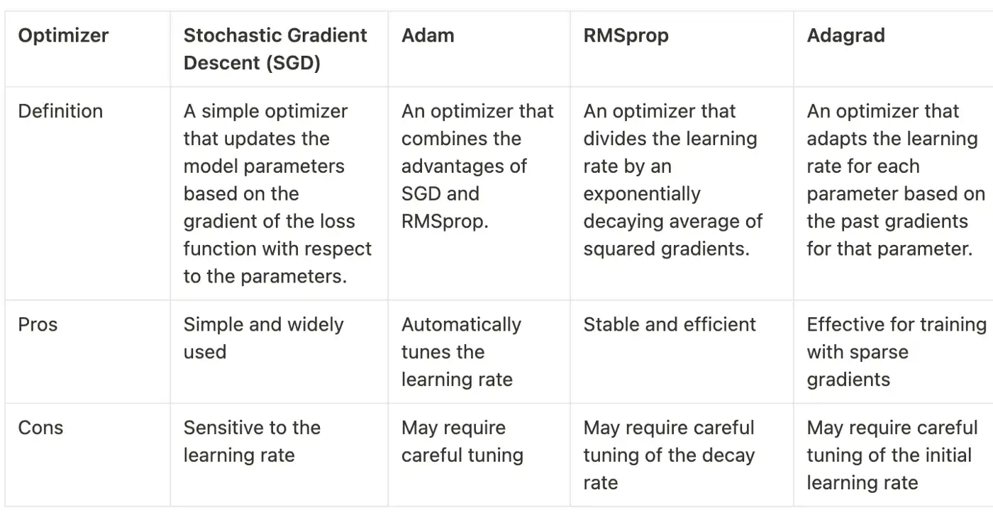
Differences between optimizers

Slide 10
SELF-ASSESSMENT QUESTIONS
Who invented RMSprop?
Geoff Hinton.
T/F Adam better than RMSProp.
True
3 The suggested value of β is __________________
0.9

Slide 11
TERMINAL QUESTIONS
List out limitations of gradient descent
What is drawback of Rms prop
compare various optimization algorithms
Why RMSprop is better than Adam

Slide 12
REFERENCES FOR FURTHER LEARNING OF THE SESSION
Books:
1 Ian Goodfellow and Yoshua Bengio and Aaron Courville (2016) Deep Learning Book

